Slide 1
HackEDbeta 2024
Introduction to the Raspberry Pi Pico
Steven Knudsen, PhD PEng
knud@ualberta.ca

Slide 2




Slide 3
Outline
Raspberry Pi Pico and Pico W overview
Setting up for MicroPython
Setting up for C/C++
What about Rust?
Wokwi.com and Pico

Slide 4
Sources for the talk
github.com/StevenKnudsen/HackEDbeta2024Workshop

Slide 5
Assumptions
You know how to program in at least one of the languages
Python or C
You have a Pico
You have two if you want to program in Rust

Slide 6
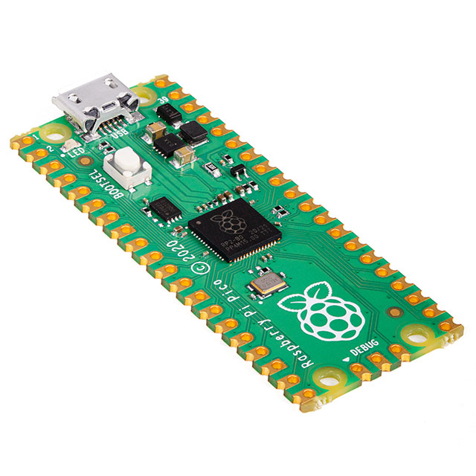
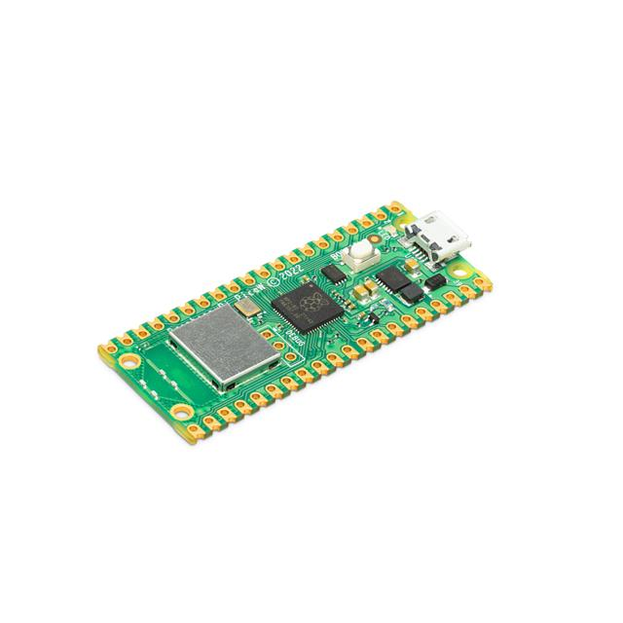
Raspberry Pi Pico and Pico W
Raspberry Pi Pico is a low-cost, high-performance microcontroller board with flexible digital interfaces. Key features include:
RP2040 microcontroller chip designed by Raspberry Pi in the United Kingdom
Dual-core Arm Cortex M0+ processor, flexible clock running up to 133 MHz
264 kB of SRAM, and 2MB of on-board flash memory
USB 1.1 with device and host support
Low-power sleep and dormant modes
Drag-and-drop programming using mass storage over USB
26 × multi-function GPIO pins
2 × SPI, 2 × I2C, 2 × UART, 3 × 12-bit ADC, 16 × controllable PWM channels
Accurate clock and timer on-chip
Temperature sensor
Accelerated floating-point libraries on-chip
8 × Programmable I/O (PIO) state machines for custom peripheral support
Images from digikey.ca

Slide 7
Raspberry Pi Pico and Pico W
$CA5.80 at Mouser.ca $CA8.34 at canada.newark.com
Images from digikey.ca

Slide 8
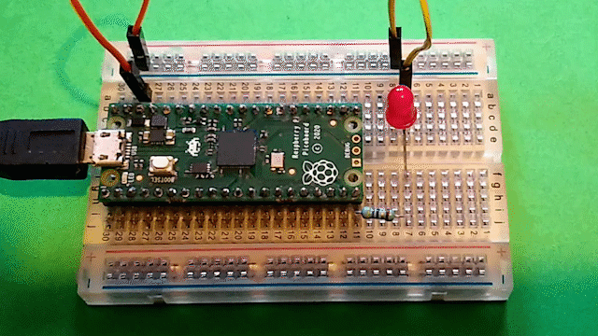
Getting started with the Pico - MicroPython
The main reference is a very good tutorial
https://projects.raspberrypi.org/en/projects/getting-started-with-the-pico/0

Slide 9
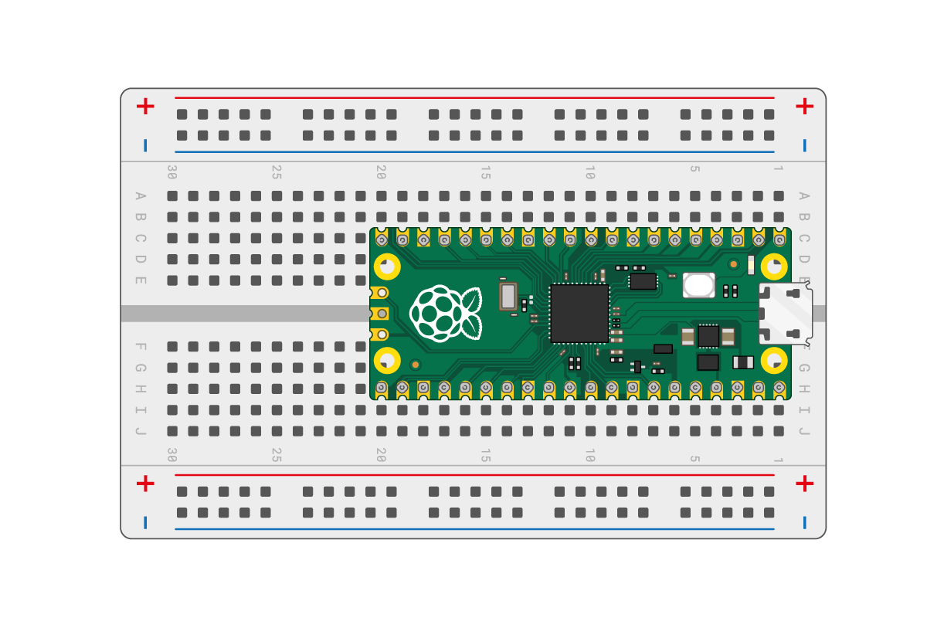
Pico on breadboard
https://projects.raspberrypi.org/en/projects/getting-started-with-the-pico/1

Slide 10
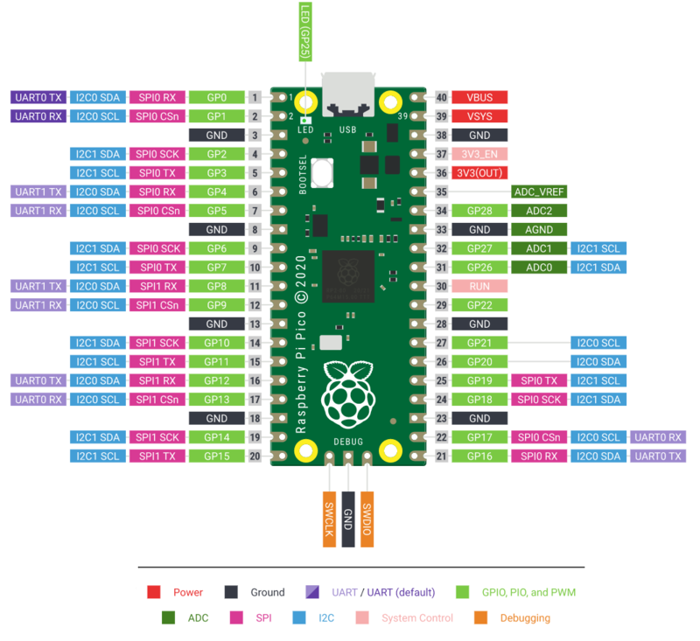
RPi Pico Pins

Slide 11
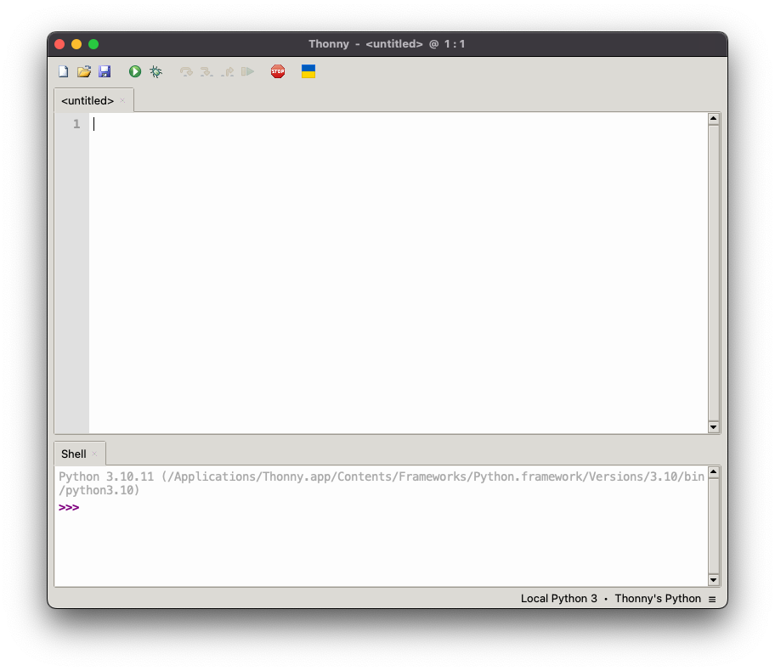
Install Thonny
(Win/Lin/macOS)
Notes:
This is Thonny, a beginner Python IDE. Happens to be running on a MacBook Pro, but same for other OSes

Slide 12
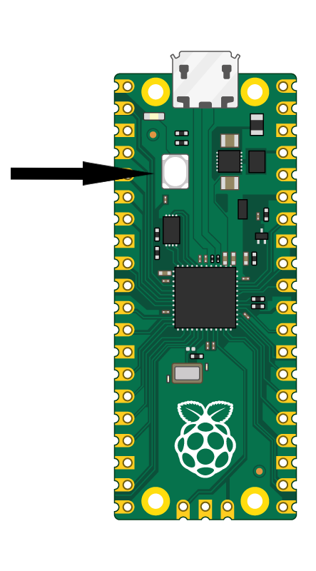
Pico in boot select (bootsel) mode
Unplug Pico from USB
Press and hold bootsel button
Plug Pico into USB and wait a few seconds
Release bootsel button
Open Thonny
https://projects.raspberrypi.org/en/projects/getting-started-with-the-pico/3

Slide 13
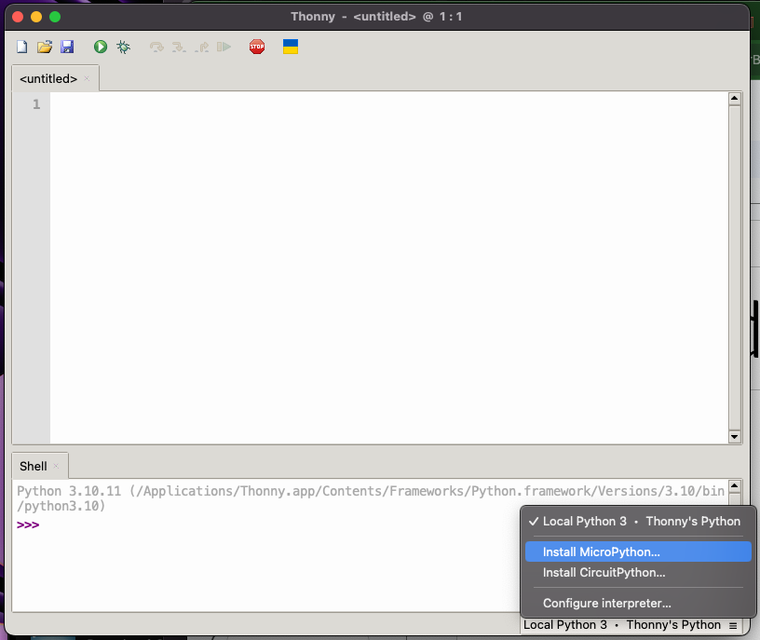
Install
MicroPython
Notes:
Open the hamburger menu in the lower right corner and select install micropython

Slide 14
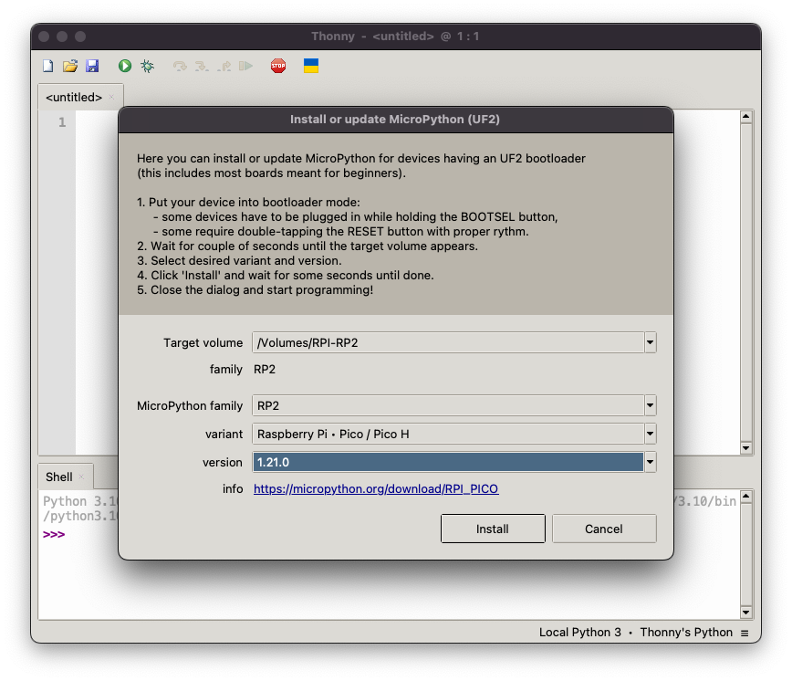
Install dialogue
Notes:
The RPi will disconnect when this is done, then reconnect

Slide 15
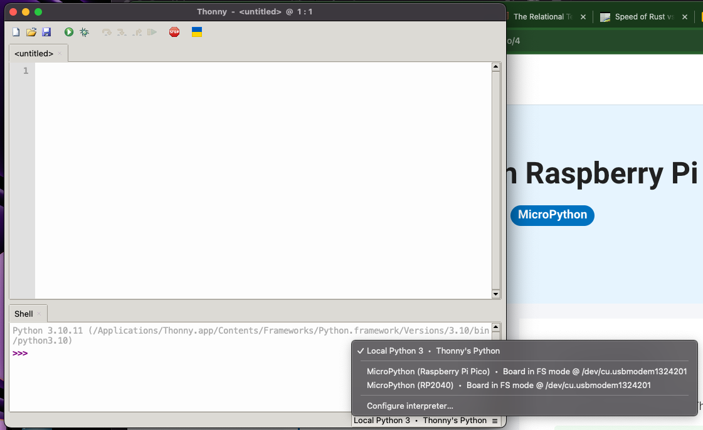
Connect
Notes:
We need to connect to the Pico. Again, open the hamburger menu. Notice these are both really the same, so it doesn’t matter which we choose.

Slide 16
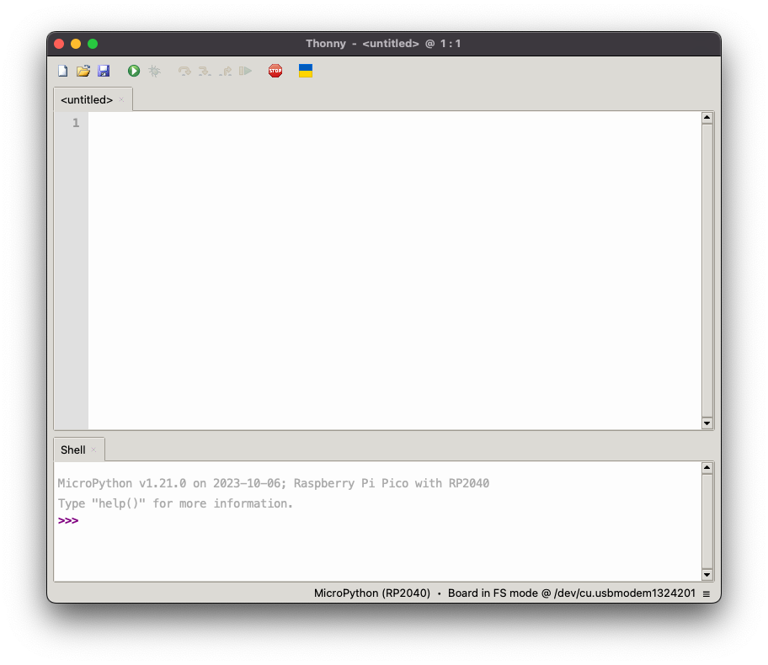

Slide 17
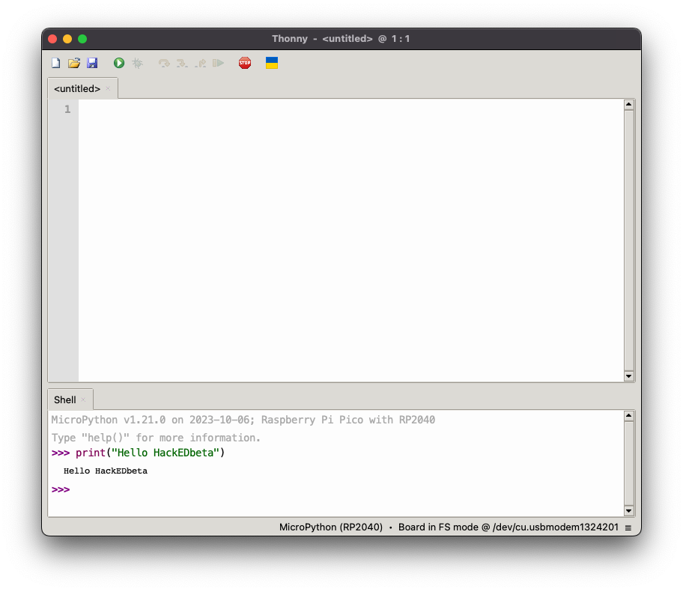
Success!

Slide 18
GPIOs
Lots of support for GPIO and other peripherals at MicroPython.org
Quick Reference for MicroPython is found at
https://docs.micropython.org/en/latest/rp2/quickref.html
Support for
HW Timers, GPIO, UART, PWM, ADC, SW SPI, HW SPI, SW I2C, HW I2C, I2S, RTC, WDT, OneWire, NeoPixel, APA106
… but probably not …

Slide 19
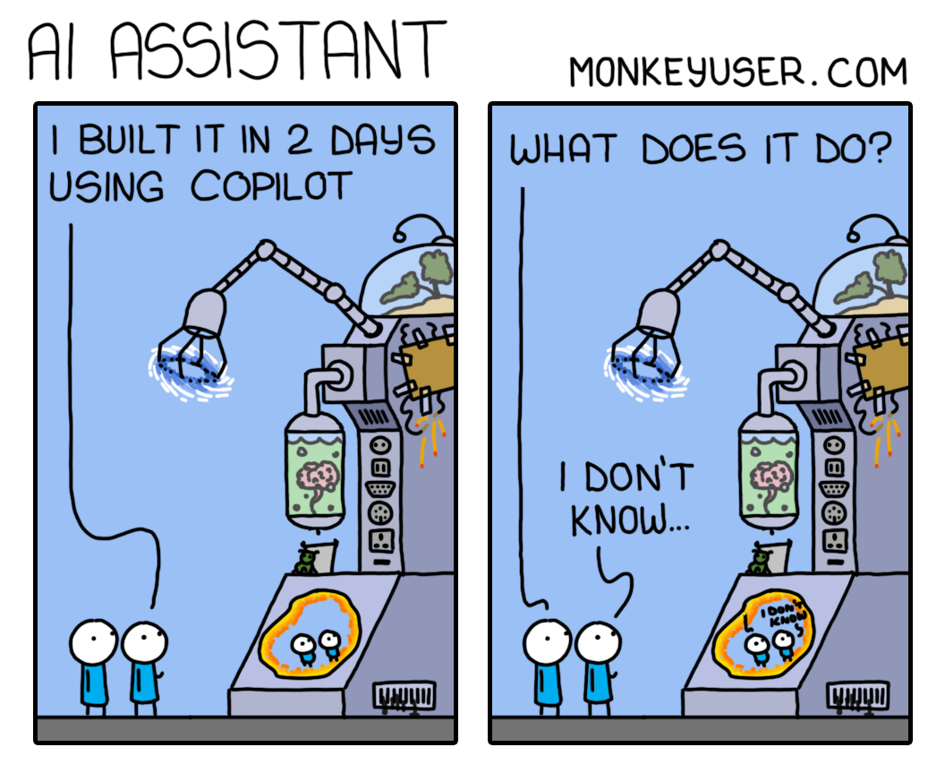
monkeyuser.com

Slide 20
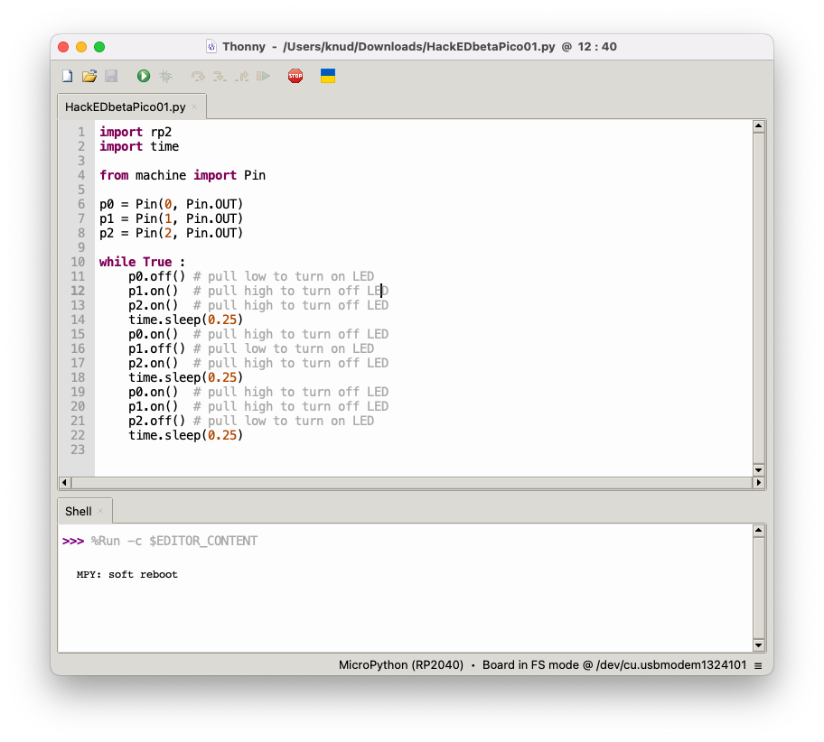
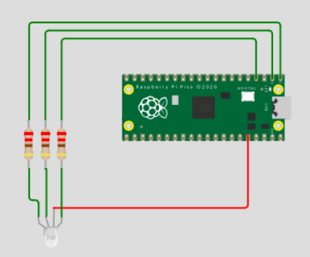
Simple RGB blinky

Slide 21

Live demo

Slide 22
Getting started with the Pico - C/C++
The main reference is the RPi documentation
https://www.raspberrypi.com/documentation/microcontrollers/c_sdk.html
As per that page there are on Github an SDK and Examples repos
Will use Ubuntu 24.04 for the following, but instructions for Win and macOS are on the link above
(Could set up development on a Raspberry Pi, but we won’t for HackEDxx)

Slide 23
Toolchain and SDK install
Need cmake and the GCC ARM toolchain
Make a top-level directory in my Development directory to clone the SDK into
Clone the Pico examples
sudo apt install cmake gcc-arm-none-eabi libnewlib-arm-none-eabi libstdc++-arm-none-eabi-newlib
cd ~Development
mkdir RPi; cd RPi
git clone https://github.com/raspberrypi/pico-sdk.git
git clone https://github.com/raspberrypi/pico-examples.git

Slide 24
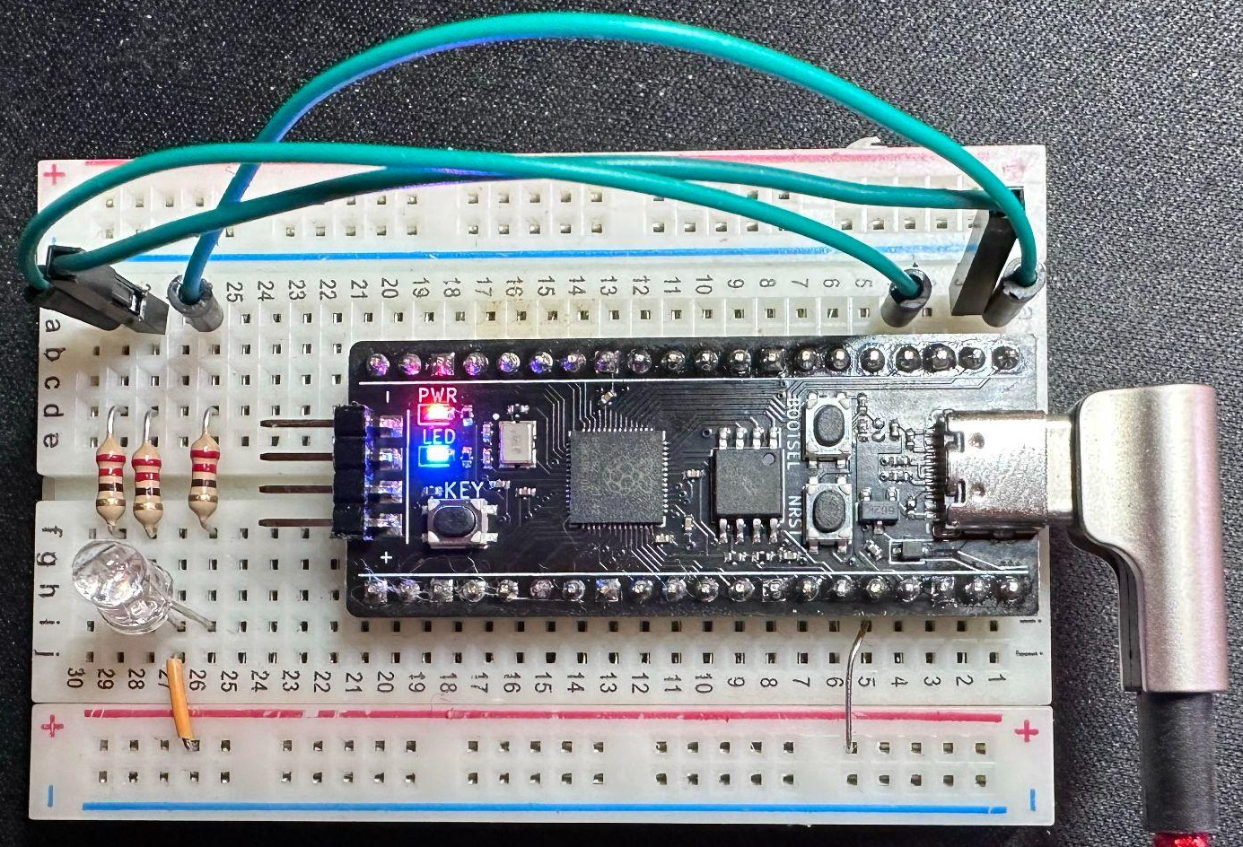
Follow the Getting Started
Different Pico
From Universal Solder
Follow the Getting Started Guide…
Do the “blink” example to be sure the tool chain is up and running.
For this example I use an RP2040 board from Universal Solder.
Pressing BOOTSEL while plugging it in results in it looking like a storage device. Programming is drag’n’drop

Slide 25
Blink example
Let’s make sure the blink example works
The build will take a long time since all the examples will be compiled…
cd ~Development/RPi/pico-examples
mkdir build; cd build
cmake ..
make –j4

Slide 26
Blink example
When complete, connect power to the Pico while holding the boot select button. The Pico will mount as a storage device. Drag and drop ~Development/RPi/pico-examples/build/blink/blink.uf2 onto the Pico
The blue LED should blink

Slide 27
Replicate previous MicroPython Example
The main steps to make a custom C/C++ application are
In pico-examples copy blink folder and contents
Rename blink.c to rgb_demo.c and edit the CMakeLists.txt file replacing blink with rgb_demo
cd ~/Development/RPi/pico-examples cp -dpR blink rgb_demo
cd rgb_demo

Slide 28
Replicate previous MicroPython Example cont’d
In the pico-examples directory, edit the CMakeLists.txt file
Find where the blink example is added
Replicate those lines and replace blink with rgb_demo
Change directory in to the build directory and execute cmake ..
There should be a new directory named rgb_demo. Change directory into it and execute
make -j4
There should be a new executable named rgb_demo.
Put the Pico back into bootloader mode and drop the rgb_demo.uf2 file on the drive – the old blink demo should work

Slide 29
#include "pico/stdlib.h"
#include "hardware/gpio.h"
const uint8_t RGB_PIN1 = 0;
const uint8_t RGB_PIN2 = 1;
const uint8_t RGB_PIN3 = 2;
int main() {
gpio_init(RGB_PIN1);
gpio_set_dir(RGB_PIN1, GPIO_OUT);
gpio_init(RGB_PIN2);
gpio_set_dir(RGB_PIN2, GPIO_OUT);
gpio_init(RGB_PIN3);
gpio_set_dir(RGB_PIN3, GPIO_OUT);
while (true) {
gpio_put(RGB_PIN1, 0);
gpio_put(RGB_PIN2, 1);
gpio_put(RGB_PIN3, 1);
sleep_ms(250);
gpio_put(RGB_PIN1, 1);
gpio_put(RGB_PIN2, 0);
gpio_put(RGB_PIN3, 1);
sleep_ms(250);
gpio_put(RGB_PIN1, 1);
gpio_put(RGB_PIN2, 1);
gpio_put(RGB_PIN3, 0);
sleep_ms(250);
}
}
Let’s replace the rgb_demo.c source with the equivalent of the python

Slide 30
GOTCHA!

Slide 31
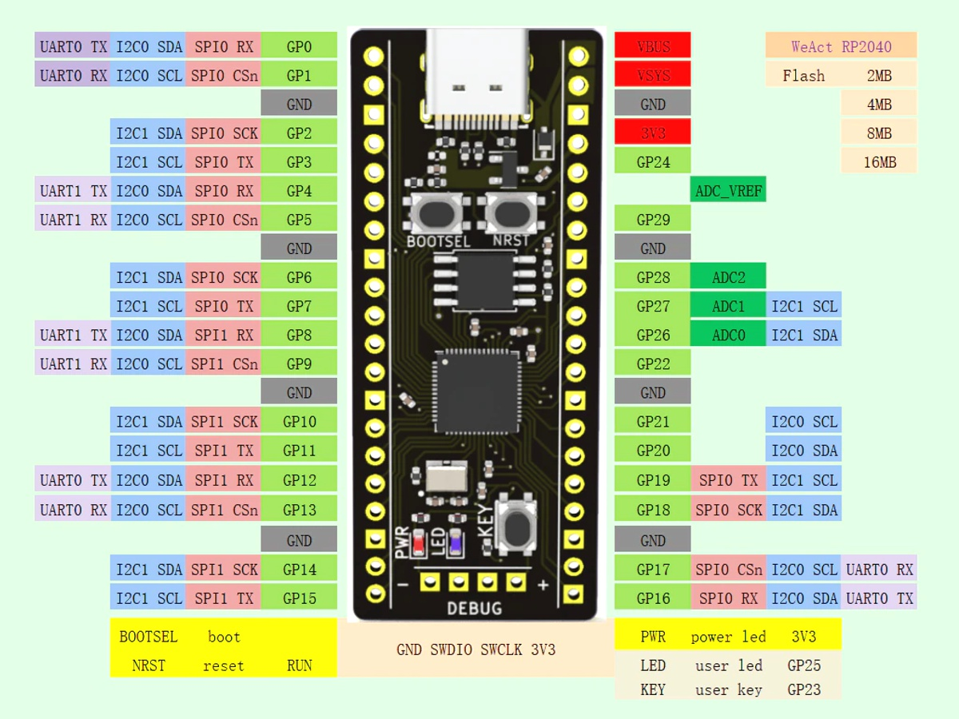
NOT THE SAME!

Slide 32
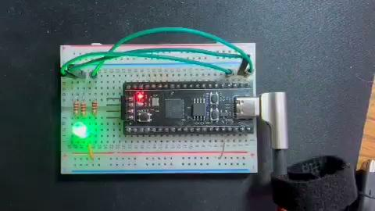
Live demo

Slide 33
What about Rust
Doable
However, we don’t have time today to go through all the steps, it’s involved!
https://reltech.substack.com/p/getting-started-with-rust-on-a-raspberry
Happy to help you if you need it for HackEDbeta

Slide 34
One more tool – Wokwi.com

Slide 35
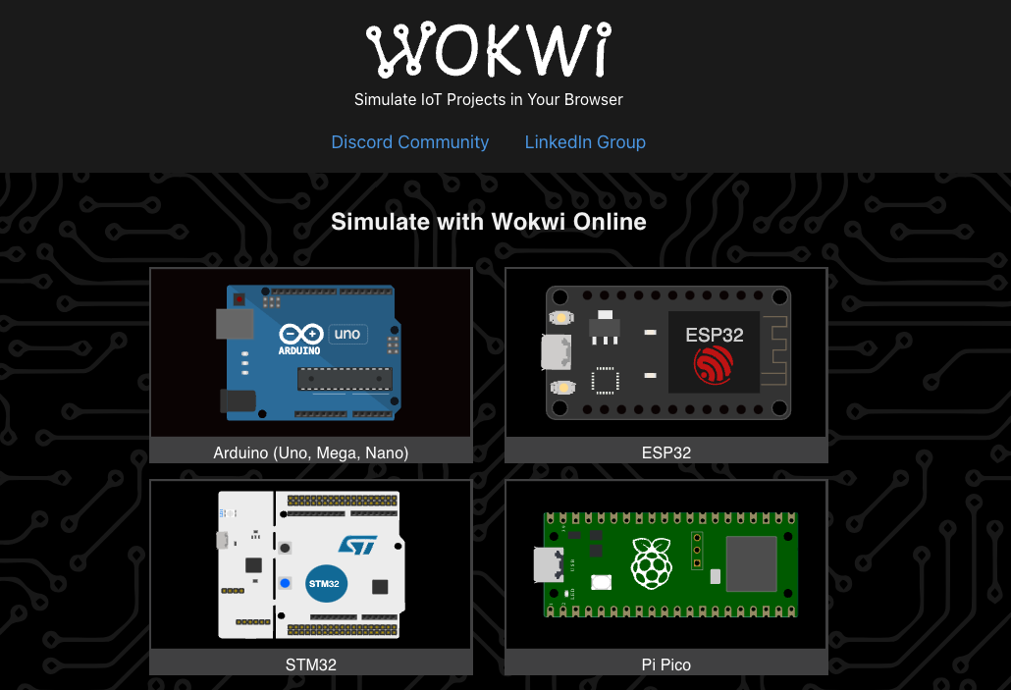

Slide 36
What is Wokwi.com? (from docs.wokwi.com)
Wokwi is an online Electronics simulator. You can use it to simulate Arduino, ESP32, STM32, and many other popular boards, parts and sensors.
Here are some quick examples of things you can make with Wokwi:
Arduino Uno "Hello World"
Blink an LED on ESP32
Monitor the weather on ATtiny85
Control 32 Servos with Arduino Mega
Animate an LED Matrix with FastLED
7 Segment Counter with MicroPython on ESP32
…and Pico!

Slide 37
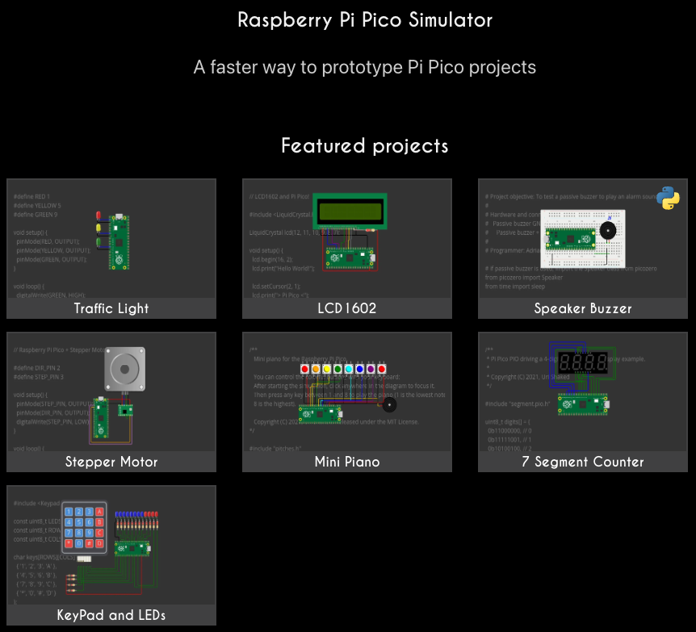

Slide 38
Simple RGB blinky

Slide 39
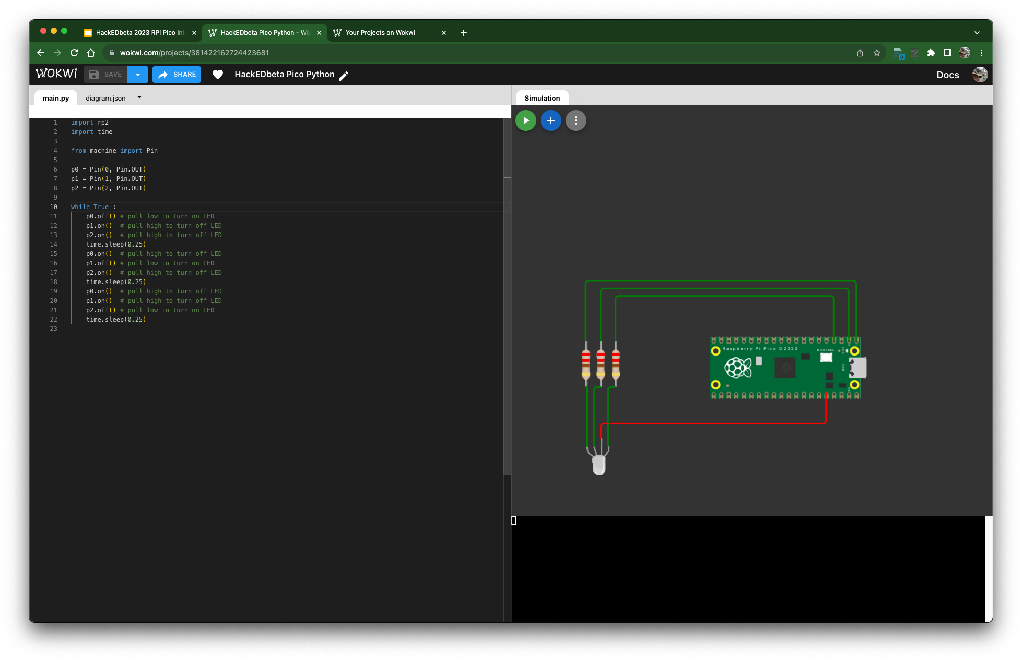
Wokwi Version

Slide 40
Trivia
...with wee prizes...

Slide 41
Trivia
Who created the first artificial neural network and when?

Slide 42
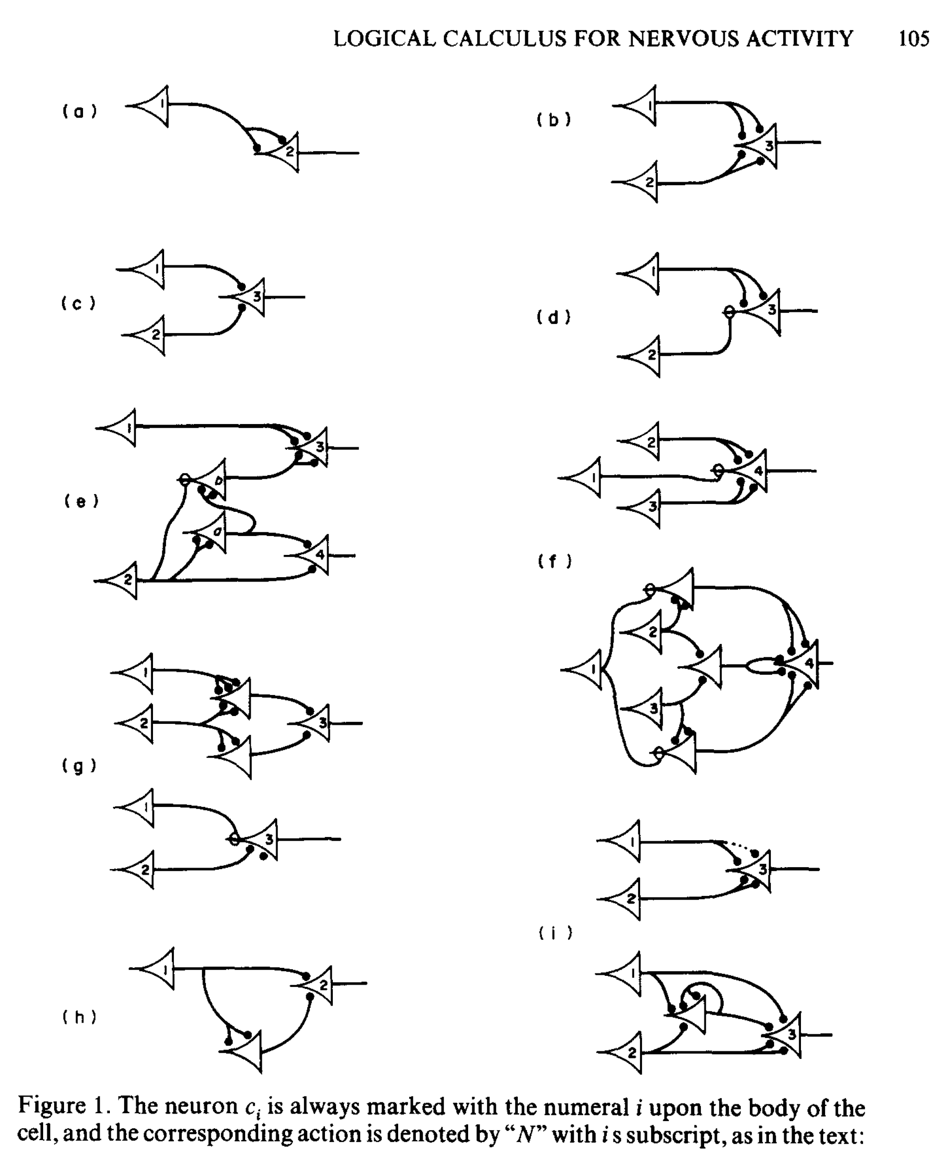
Warren McCulloch and Walter Pitts
1943
Perceptron
Modelled using electrical circuits
Notes:
Prize 1 chosen

Slide 43
Trivia
What is an equivalent to the U of A’s main frame computer from the 80s?

Slide 44
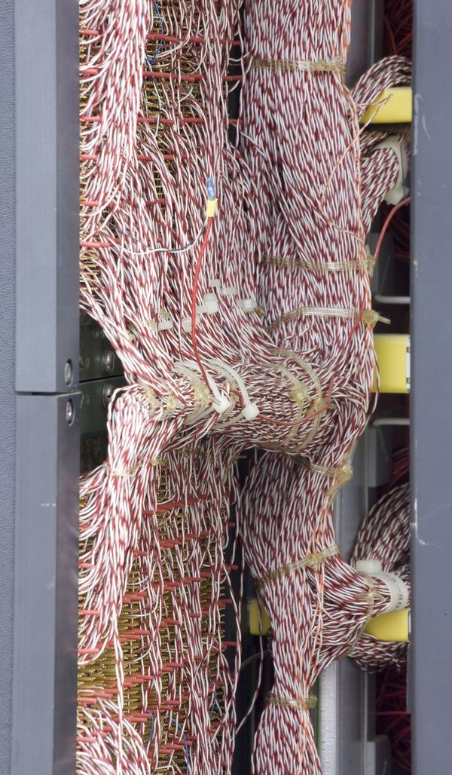
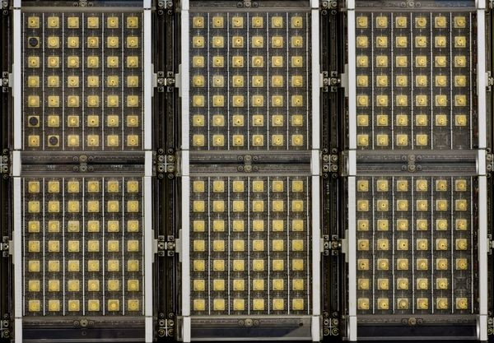
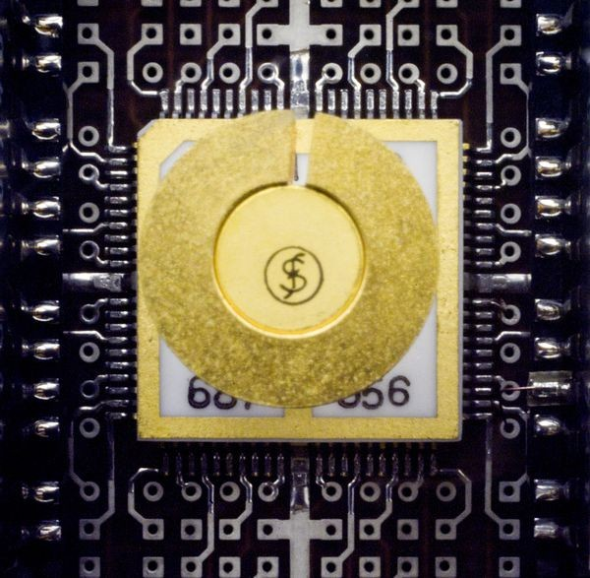
Amdahl 470 v/6
Date Introduced : 1975
Dimensions overall: 63” x 70” x 26”
Keywords : Clones; Plug compat; IBM
Speed : 3.5 MIPS
Memory Size : up to 8MB
Memory Width : 32-bit
Cost : $3,750,000 (2020 $17,981,250)

Slide 45
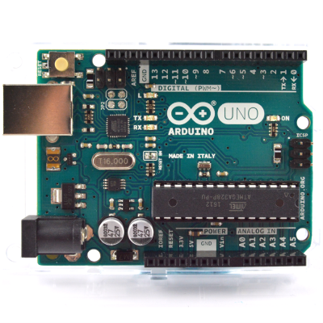
Arduino
Date Introduced : 2010
Dimensions overall: 2.7” x 2.1” x 0.6”
Speed : 8 - 11 MIPS
Memory Size : 32k FLASH 2k SRAM
Cost : ~$20
Cost to make : < $5

Slide 46
Trivia
What are the most loved and hated languages in the 2022 Dice survey
Notes:
https://www.dice.com/career-advice/20-programming-languages-that-developers-love-the-most

Slide 47
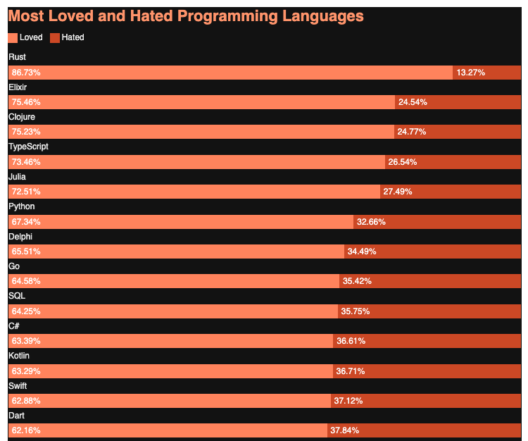
Most loved
Rust 86.83%
Elixir 75.46%
Clojure 75.23%
TypeScript 73.46%
Julia 72.51%
Python 67.34%

Slide 48
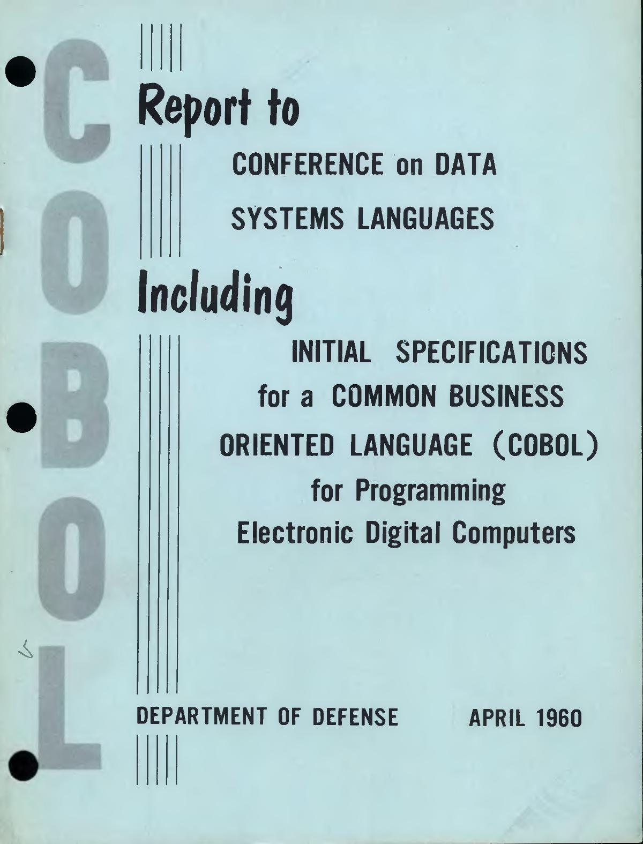
Most hated
VBA (78.56 percent).
COBOL (hated by 79.96 percent of developers)
MATLAB (80.84 percent), and

Slide 49
Most hated
VBA (78.56 percent).
COBOL (hated by 79.96 percent of developers)
MATLAB (80.84 percent), and

Slide 50
